Slide 1
Open Source Hardware Isn’t Hard
Toni Klopfenstein
https://github.com/ToniCorinne/OpenSource101
Notes:
Lots of links available in the slides
Open source all the things!

Slide 2
Overview
Who am I?
History of Open Source Hardware (OSHW)
What is Open Source Hardware?
Pros/Cons of OSHW
Current State of the OSHW Community
How to Get Involved
Q/A
Notes:
Quick overview of the talk
History of OSHW and brief comparison to OS software
Pros/Cons of engaging in open source hardware

Slide 3

Why am I here?
Employee @ SparkFun Electronics 2011-Present
OSHWA Board Member 2014-2016
Open Hardware Summit Sponsorship Chair 2015-2016
Open-source participant
Photo by: Joel E. B.
Notes:
Background for my biases
SFE - tech support rep, engineering quality assurance, engineering QA manager, participated in many workshops and events across the country
OSHWA board member - joined after participating in the Summit 2x and the Documentation Jam
Summit sponsorship chair - encouraging companies and groups to participate
Build I completed and documented

Slide 4
History of OSHW
Open Hardware Certification - 1997
First Hardware Specific License - TAPR, 2007
Open Source Design and Hardware Alliance - Certification work in 2009
First Open Hardware Summit - 2010
Open Source Hardware Definition 1.0 - 2010
CERN Open Hardware License - 2011
Logo Disputes - 2011
OSHWA Officially Organized - 2012
Received non-profit tax status - 2014
Source: http://www.oshwa.org/definition
Notes:
OSS - 1983 GN U project launch w/ Richard Stallman (14 year leap on hardware)
Free Software Definition launched in 1986
Linux in 1992 under GNU license (5 years ahead of hardware)
Open Hardware Organization (97 by Bruce Perens) vs. Open Source Hardware (similar to Free Software vs Open Source argument)
TAPR - Tuscon Amatuer Packet Radio Corporation
OHANDA - seems to be defunct (2013)
OSI claimed trademark infringement on gear logo (selected by community vote)

Slide 5

Open Source Hardware Definition:
“Open source hardware is hardware whose design is made publically available so that anyone can study , modify, distribute, make, and sell the design or hardware based on that design. “
Source: http://www.oshwa.org/definition,
http://www.oshwa.org/open-source-hardware-logo/
Notes:
Current definition of OSHW
“The hardware’s source, the design from which it is made, is available in the preferred format for making modifications to it. Ideally, open source hardware uses readily-available components and materials, standard processes, open infrastructure, unrestricted content, and open-source design tools to maximize the ability of individuals to make and use hardware.”
Created in 2010, adopted in 2011 by collaborators from Arduino team, Adafruit, SparkFun, littleBits, Parallax, MakerBot, MAKE, MIT and others

Slide 6
Criteria:
Documentation
Scope
Necessary Software
Derived Works
Free Redistribution
Attribution
No Discrimination Against Persons or Groups
No Discrimination Against Fields of Endeavor
Distribution of License
License Must Not Be Specific to a Product
License Must Not Restrict Other Hardware or Software
License Must Be Technology Neutral
Source: http://www.oshwa.org/definition
Notes:
Driving theme - it must be inclusive (documentation, software, all of this leads back to usability across the board)
Scope - apple round corners vs samsung
Tech neutral - can’t be preferential to one type of technology

Slide 7
Cons
Diligence is required
Enforcement of licenses can be difficult
Costs time, money
Isn’t always successful
Cease and Desists
Licensing is hard
MIT
Creative Commons
CERN OHL
GNU GPL
TAPR OHL
BSD
Notes:
Easy to forget one aspect of checking an OS design (i.e., Binary firmware blobs)
Many license are heavily software focused
CC - SA vs. CC -A
2-clause vs 3-clause BSD

Slide 8
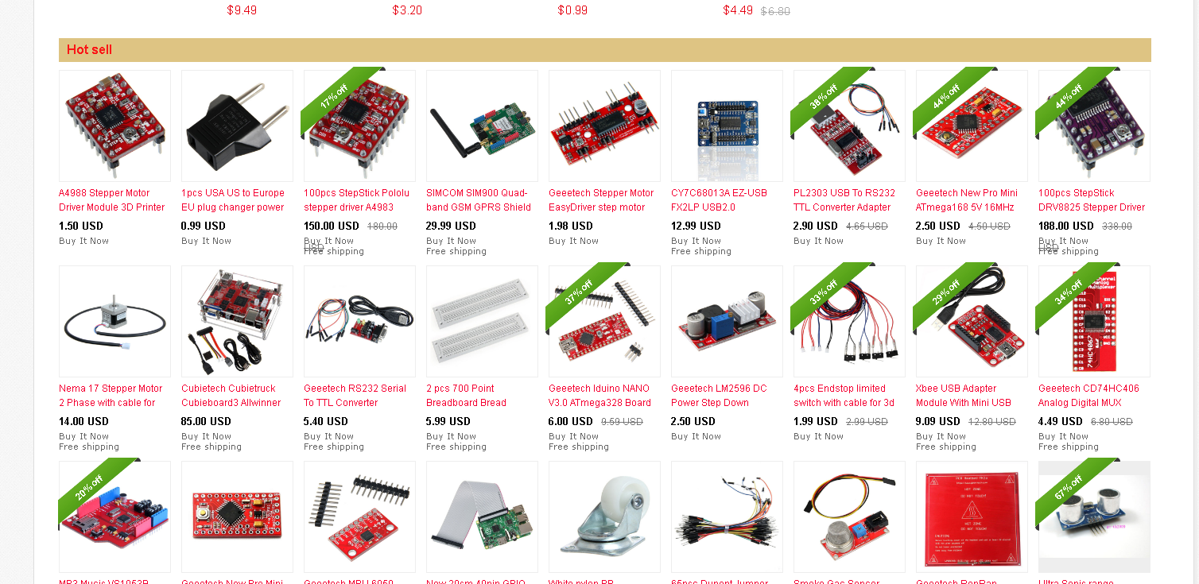
Cons
Success = you will be cloned
Source: http://www.ebay.com/itm/Geeetech-Low-3-5-PCA9306-dual-bidirectional-voltage-level-translator-Breakout-/271148344132?hash=item3f21b36344:g:vXwAAOSwh6xTtkn:

Slide 9
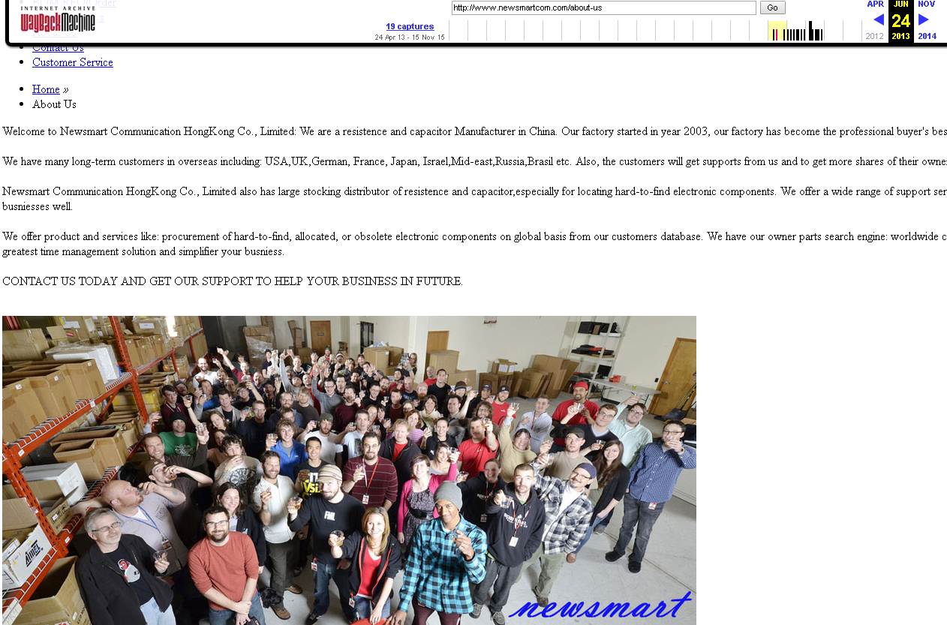
Source: https://web.archive.org/web/20130624231444/http://www.newsmartcom.com/about-us

Slide 10
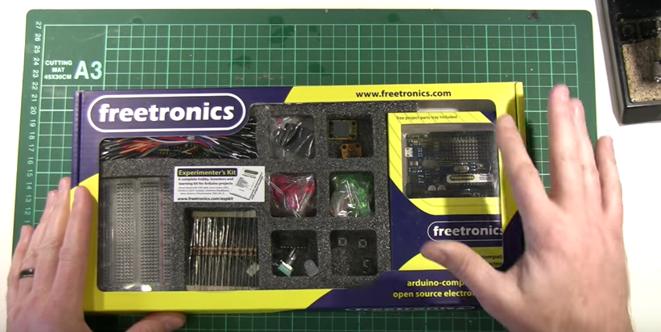
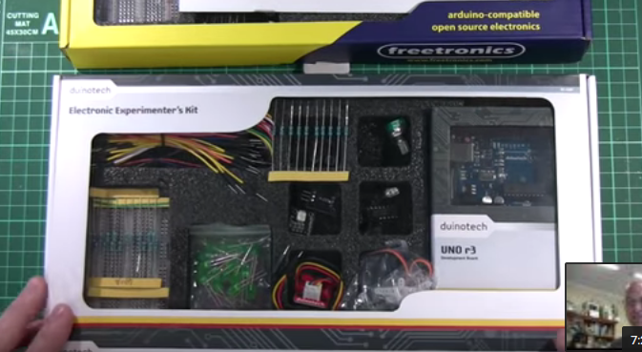
Freetronics Experimenter’s Kit
Duplicated by Duinotech/Jaycar
Source: https://www.youtube.com/watch?v=SW8K9D9u5aI
Notes:
400K views (social media outcry)
Duinotech has been petitioned

Slide 11
Pros
Save Money on Patent Filings
Can easily be >$10K
Source:https://www.uspto.gov/learning-and-resources/fees-and-payment/uspto-fee-schedule
Save Money on Patent Litigation Suits
Can easily be >$100K
Source:http://files.ctctcdn.com/e79ee274201/b6ced6c3-d1ee-4ee7-9873-352dbe08d8fd.pdf
Drives Innovation
Drives a Better Customer Experience
Allows for Crowd-Sourcing Improvements
Free Advertising
Community Support
Encourage Repair/Reuse
Supports Consumer Rights
Notes:
Small businesses often can’t afford the patent filing costs alone, much less lawyers/time/resources to enforce patents
American Intellectual Property Law Association survey results of patent attorneys
Free advertising -someone uses your design and properly gives you attribution (can get you into markets you wouldn’t normally get into)
Community will usually defend you if needed

Slide 12
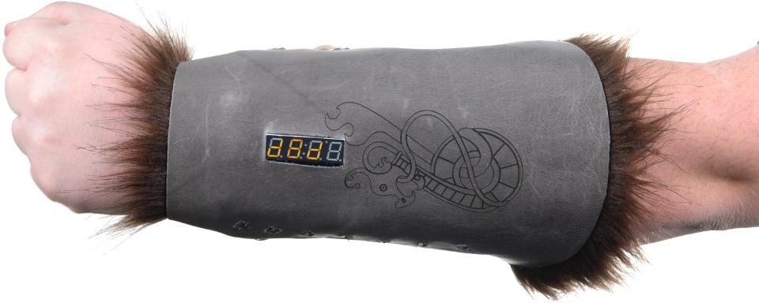
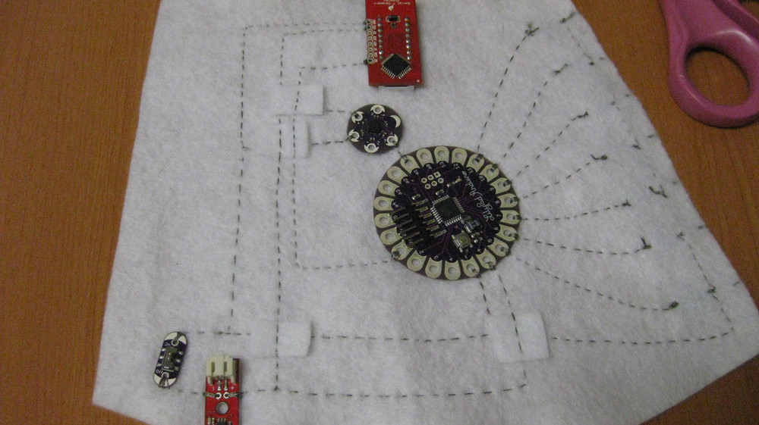
D&D Bracer
Demo Project
7 Separate Products
Source: https://learn.sparkfun.com/tutorials/dungeons-and-dragons-dice-gauntlet
Notes:
D&D bracer

Slide 13
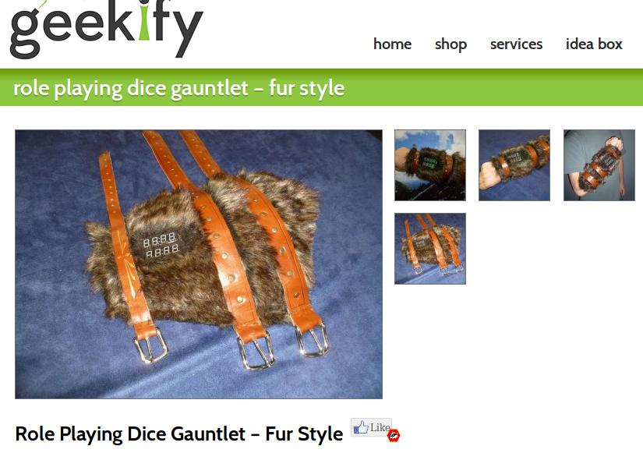
Actualized Product
Didn’t Affect Our Sales
Source: http://geekifyinc.com/product/role-playing-dice-gauntlet-fur-style/

Slide 14
Current State of the Community
Citizen Science
Public Lab
Open Source Beehives
Ecology
Open Source Ecology
FarmBot
Communications
PirateBox
Fairphone
Textiles
Open Knit
FabTextiles
Bio
Open Hand Project
Open Bionics
Open Prosthetics
OpenBCI
Four Thieves Vinegar
Furniture/Housing
OpenDesk
WikiHouse
Machines
Open-Source Vehicle
Open ROV
Notes:
Open Source Ecology - Global Village Construction Set
FairPhone - track the entire supplier line (like Project Ara, but still in the works)
Four Thieves - Open EpiPen, Open source apothecary tools

Slide 15
Electronics/Fabrication
SparkFun
Seeed
Arduino
Adafruit
Teensy
Minnowboard
ProtoCentral
LulzBot
SeeMeCNC
Handibot
Open-Electronics

Slide 16
Events of the Community
Open Hardware Summit
Varied locations, (end of Summer)
DEF CON
Las Vegas, July
HOPE
NYC,Biennial (2018)
SparkFun Autonomous Vehicle Competition
Boulder, Fall
Hackaday SuperCon
California, November
Maker Faires
Worldwide, year round
Hackerspace Events
Worldwide, year round
Notes:
Open Hardware Summit - varied locations around the world - Colorado, end of summer this year
AVC - September/October time frame
DefCon/Hope - lots of workshops
Hackaday SuperCon - conference w/ talks
Events all over for supporting the OSHW community

Slide 17
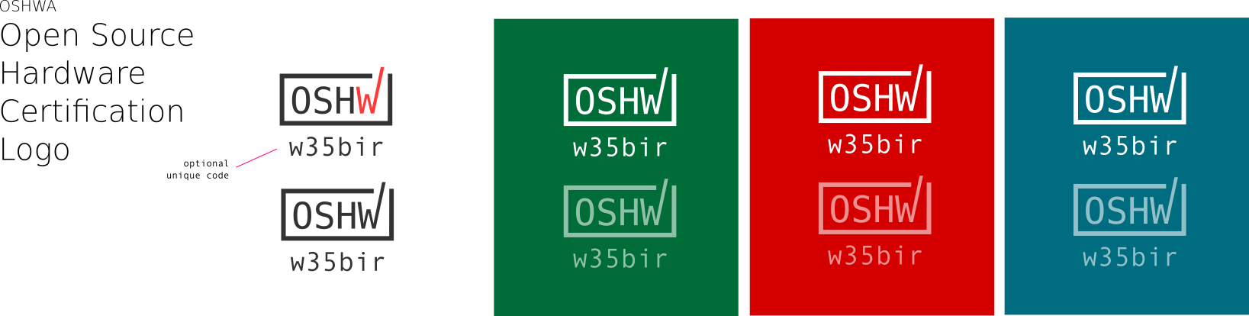
Hardware Certification
http://certificate.oshwa.org/
Launched in 2016
Updated yearly
Self-certify as open
Enforced by OSHWA
Source: https://github.com/oshwa/certification-mark
Notes:
In response to things like Raspberry Pi - often labeled open source hw, though it isn’t
Unique identifier logos were created by the community
Legally binding - makes this more official than the gear logo

Slide 18
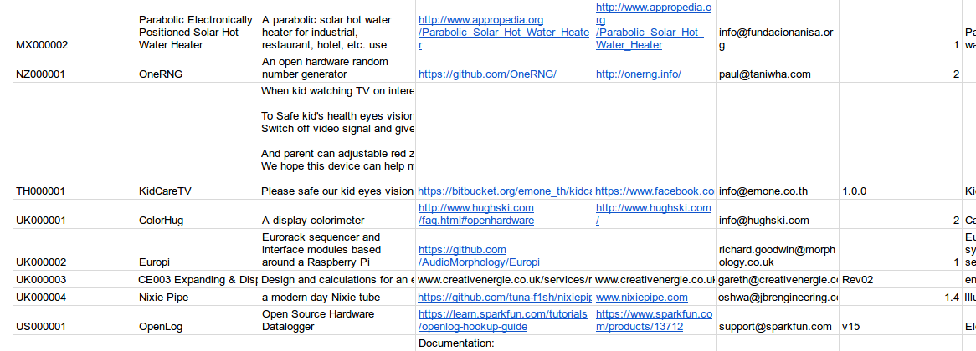
Certification Directory
Source: http://certificate.oshwa.org/certification-directory/
Notes:
Unique identifier (MX = mexico, NZ = , TH = , UK = United Kingdom, US = USA),
Includes product name, basic hardware description, link to product page, link to documentation, support email, version number, type of project
Over 70 certified hardware projects currently

Slide 19
How Can You Participate?
Solve problems yourself
Fork open-source solutions and make the world better
Contribute to ongoing projects
Check GitHub, Hackaday, Instructables, local hackerspaces
Certify your projects
Document, document, document!
Learn the licenses and teach others
Write open-source software
Support with your wallet
Tindie, inMojo
Ask questions
Notes:
Solve problems yourself - if you’re aware of an issue that needs to be fixed, build the solution yourself
Contribute - google searches will net you many, many projects you can participate in
Support with your wallet - buy from open source companies
Document - open source hardware only works if we document our builds

Slide 20
Thank You!
Questions?
GitHub/Twitter: @ToniCorinne
Email: toni@sparkfun.com
Notes:
Thanks to All Things Open, Open Source 101
Find me after - stickers/info for OSHWA/SparkFun

